Slide 1

GRAPH THEORY AND ITS APPLICATIONS
Dr. Arti Arya
Department of Computer Science & Engineering

Slide 2

GRAPH THEORY AND ITS APPLICATIONS
TREES
Dr. Arti Arya
Department of Computer Science & Engineering

Slide 3
Graph Theory and its Applications Acknowledgement
The inputs to the slides are by Dr. Surabhi Narayan and by Dr. Arti Arya. The sources of the information other than text book is mentioned wherever used.

Slide 4
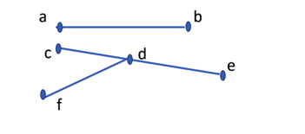

Graph Theory and its Applications Trees
Let G=(V,E) be a loop free undirected graph, then the graph G is said to be a tree if G is connected and contains no cycles.
G
If each component of a disconnected graph is a tree, then the graph is called a forest.

Slide 5

Graph Theory and its Applications
Spanning Trees
A subgraph T of graph G is called a spanning tree of G if
T is a tree and
T contains all vertices of the graph G
G
T
V

Slide 6
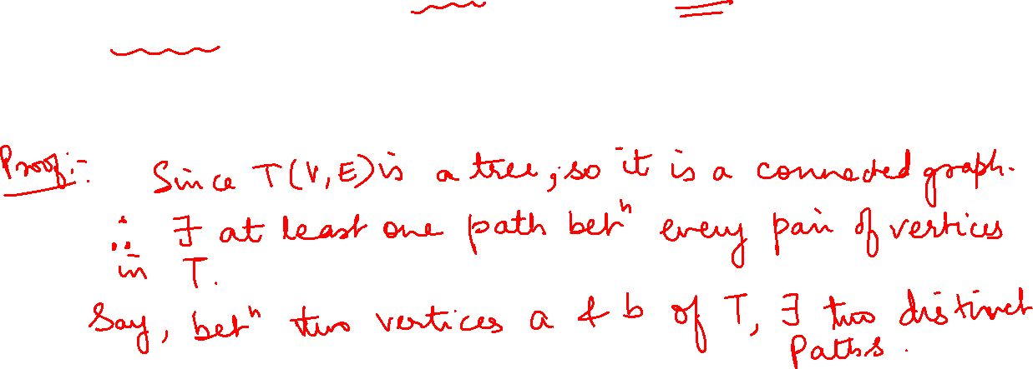
Graph Theory and its Applications
Some Properties of Trees
Theorem
If a and b are distinct vertices in a Tree T(V,E); then there is a unique path that connects these vertices
OR
There is one and only one path between every pair of vertices in a tree.

Slide 7
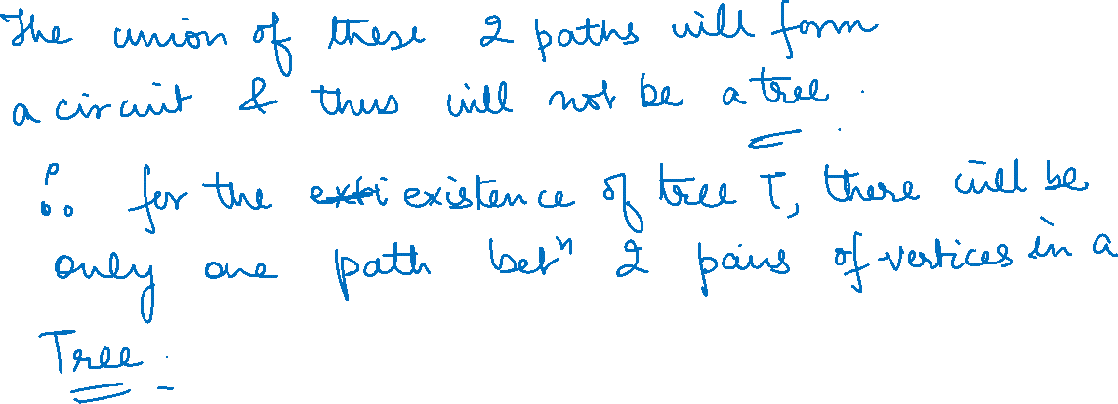

Slide 8
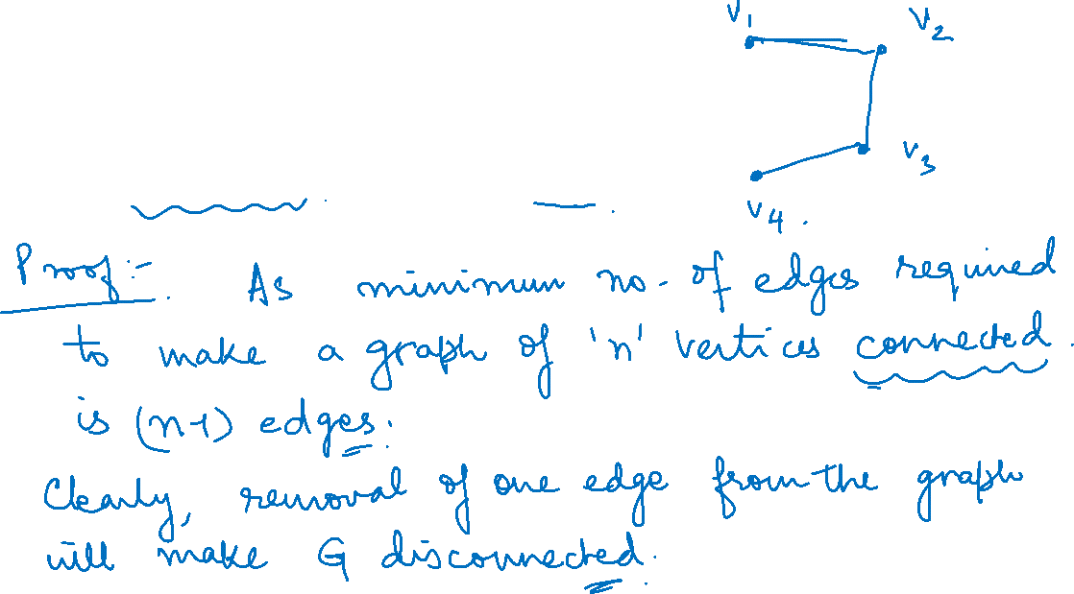
Graph Theory and its Applications Some Properties of Trees
Theorem
Any connected graph with n vertices and n-1 edges is a tree.

Slide 9
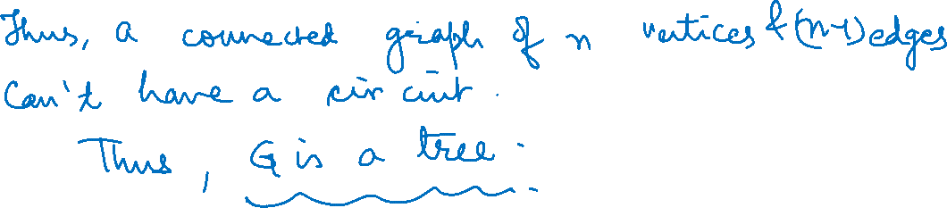

Slide 10
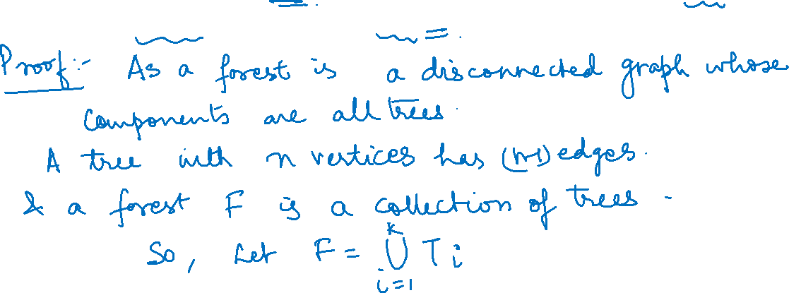
Graph Theory and its Applications
Some Properties of Trees
Theorem
Let F be a forest with k components (trees), if n is the number of vertices, m is
the number of edges in F, then prove that n=m+k

Slide 11
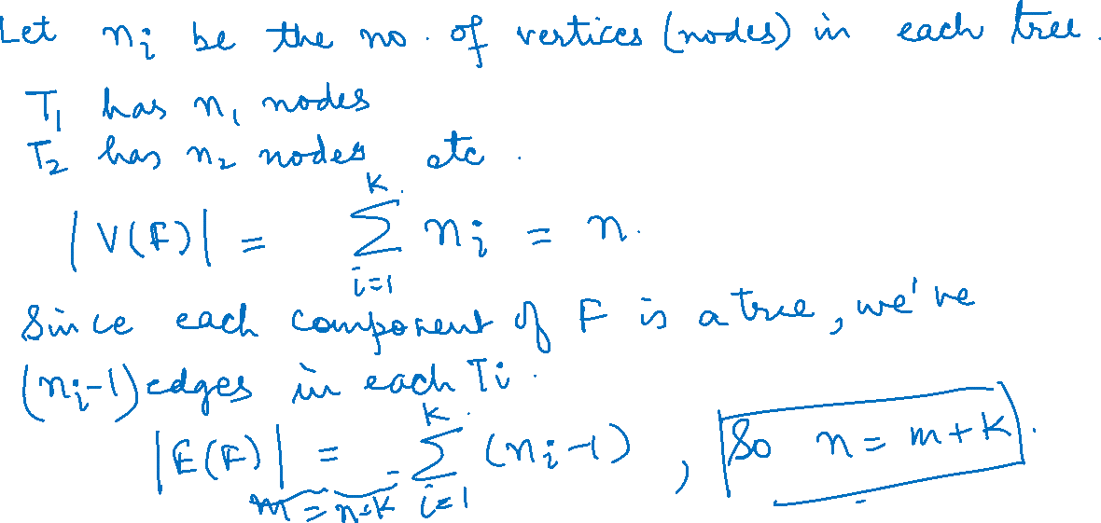

Slide 12
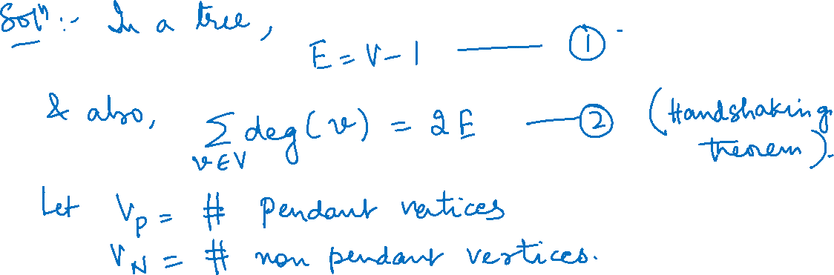
Graph Theory and its Applications
Some Properties of Trees
Show that in a tree, if the degree of every non pendant vertex is 3, then the no. of vertices in the tree is an even number.

Slide 13
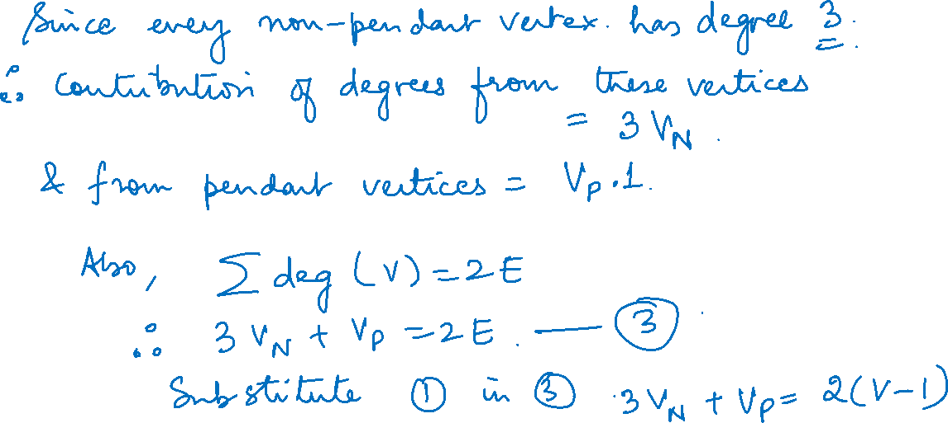

Slide 14
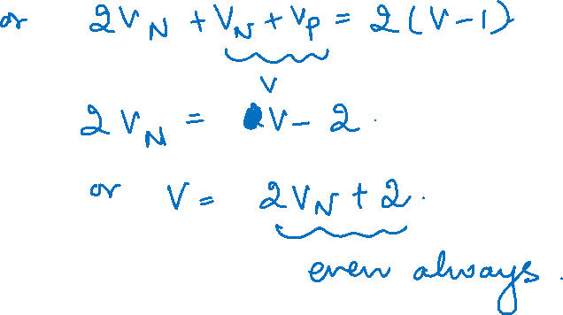

Slide 15
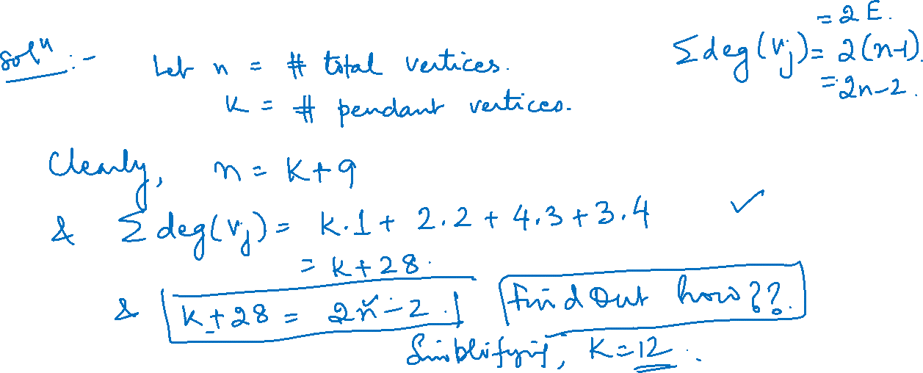
Graph Theory and its Applications
Some Properties of Trees
Suppose that a tree T has 2 vertices of degree 2, 4 vertices of degree 3 and 3 vertices of degree 4. find the number of pendant vertices in T.

Slide 16
Graph Theory and its Applications
Some Properties of Trees
If a tree T has 4 vertices of degree 2, 1 vertex of degree 3 and 2 vertices of degree 4 and 1 vertex of degree 5. find the number of pendant vertices in T.
Solve yourself

Slide 17
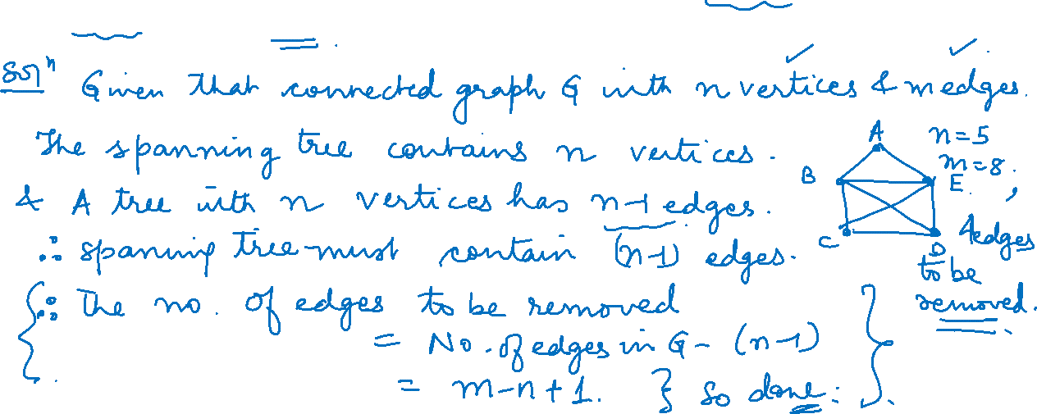
Graph Theory and its Applications
Some Properties of Trees
How many edges must be removed from a connected graph with n vertices and m edges to produce a spanning tree.

Slide 18
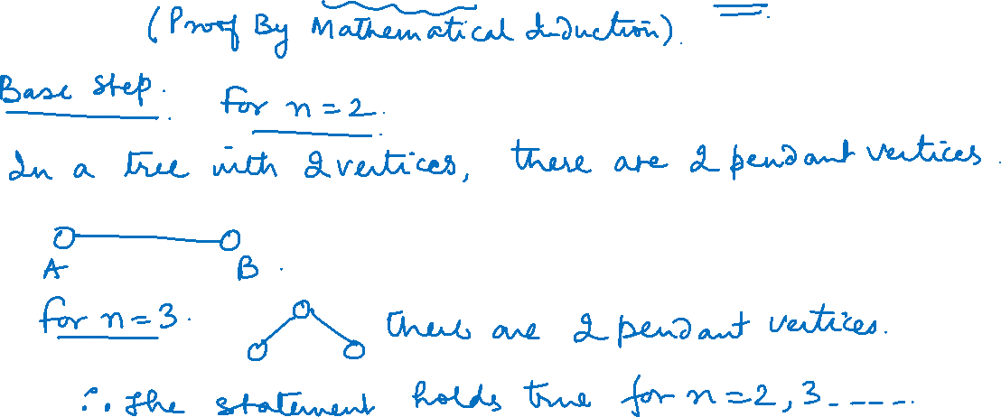
Graph Theory and its Applications
Some Properties of Trees
Prove that in a tree T with 2 or more vertices, there are atleast 2 pendant vertices

Slide 19
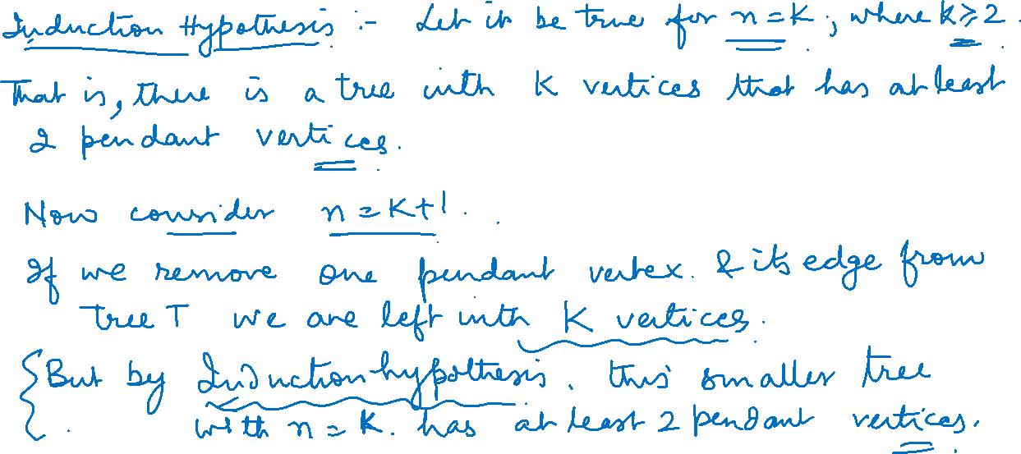

Slide 20
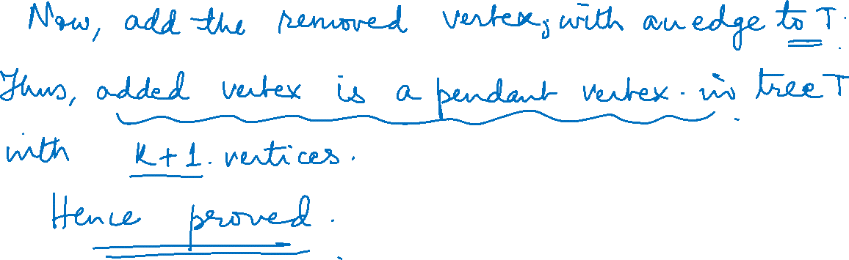

Slide 21
Graph Theory and its Applications
Some Properties of Trees
Let T₁ = (V₁ , E₁) and T₂ = (V₂, E₂) be 2 trees. If |E₁| = 19 and |V₂| = 3 *| V₁|
then determine |V₁|, |V₂| and |E₂|

Slide 22

Graph Theory and its Applications
Some Properties of Trees
Let T be a tree with 50 edges. The removal of certain edge from T yields 2 disjoint trees T₁ and T₂ given that the number of vertices in T₁ equals to the number of edges in T₂. Determine the number of vertices and number of edges in T₁ and T₂

Slide 23

Graph Theory and its Applications
Some Properties of Trees
Let F = (V,E) be a forest of seven trees where |E| = 40 Determine |V|

Slide 24

Graph Theory and its Applications
Some Properties of Trees
Let F= (V,E) be a forest with |V|=62 and |E|=51, how many trees determine F.

Slide 25
THANK YOU
Dr. Arti Arya
Department of Computer Science &Engineering
artiarya@pes.edu

